Slide 1

Integrity and Authentication

Slide 2
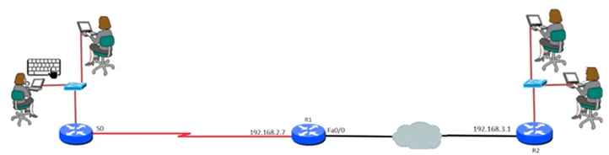
Confidentiality, Integrity, Authenticity
Confidentiality – protect information from being accessed by unauthorized parties.
Integrity – ensure information has not been modified by unauthorized parties.
Authenticity – ensure information from trusted source.(verify the users identity)
Notes:
Every cybersecurity professional or organization must achieve these 3 pronciples
Only authorized users can access the sensitive data
No body is allowed access betwwen A and B
3. If this user wants to access bank account, there should be a mechanism to authenticate th user, ensiure this is the right user who can access the account

Slide 3
Hash Functions

Slide 4
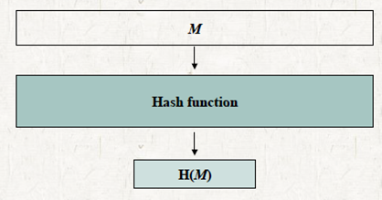
A hash function H accepts a variable-length block of data M as input and produces a fixed-size hash value h = H(M).

Slide 5
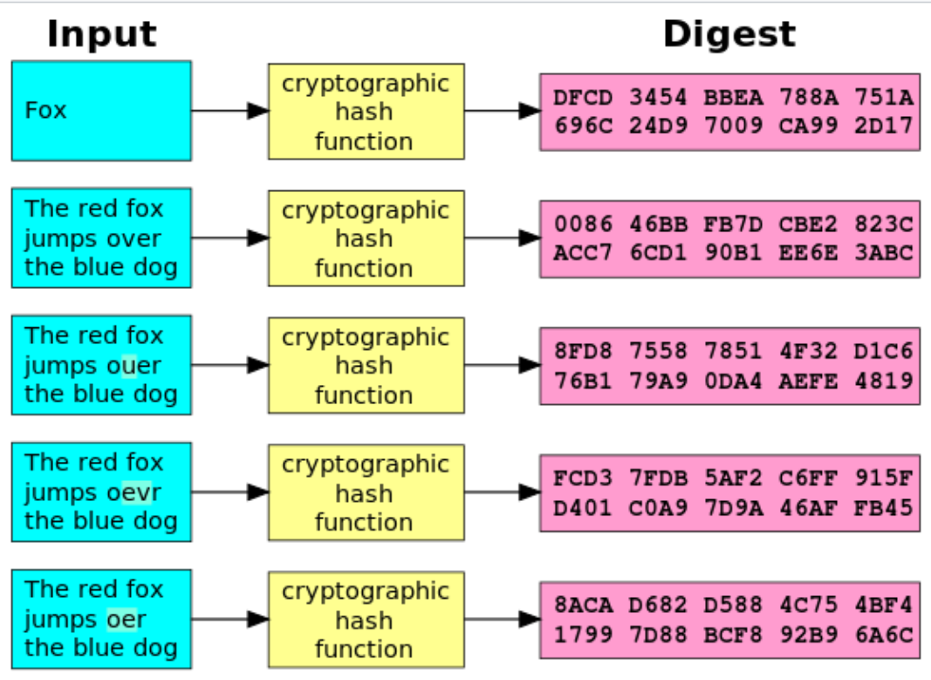
Example

Slide 6
Properties of a Hash function
A good hash function has the property that the results of applying the function to a large set of inputs will produce outputs that are evenly distributed and apparently random.
Avalanche effect: If there is a small change in the input, the output changes dramatically. This makes sure that the hash value can not be guessed based on the input values.
A good hash function should be collision resistant – never get the same hash value for different inputs.

Slide 7
Cryptographic hash functions
Hash functions used for security applications are known as cryptographic hash functions.
They have two important properties:
It is computationally infeasible to find either:
One way property: a data object that maps to a pre-specified hash result.
Collision free property: two data objects that map to the same hash result.
Notes:
Find only using brute force methd

Slide 8
APPLICATIONS OF CRYPTOGRAPHIC HASH FUNCTIONS

Slide 9
APPLICATIONS OF CRYPTOGRAPHIC HASH FUNCTIONS
Message Authentication
Digital signature
One way password file
Intrusion detection and prevention

Slide 10
(a) Message Authentication

Slide 11
Message Authentication
It is a mechanism used to verify the integrity of a message.
It assures that data received are exactly as sent (i.e., there is no modification, insertion, deletion, or replay).

Slide 12
Various Methods for Message Authentication
(using the Hash code)
Method 1 – Message and Hash code Encrypted
Method 2 – Only hash code is encrypted
Method 3 – Sharing a secret value for message authentication
Method 4 – Adding confidentiality to method 3

Slide 13
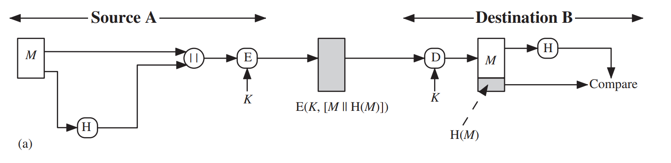
Method 1 – Message and Hash code Encrypted
The message plus concatenated hash code is encrypted using symmetric encryption.
Because only A and B share the secret key, the message must have come from A and has not been altered.
The hash code provides the structure or redundancy required to achieve authentication.
Because encryption is applied to the entire message plus hash code, confidentiality is also provided.

Slide 14
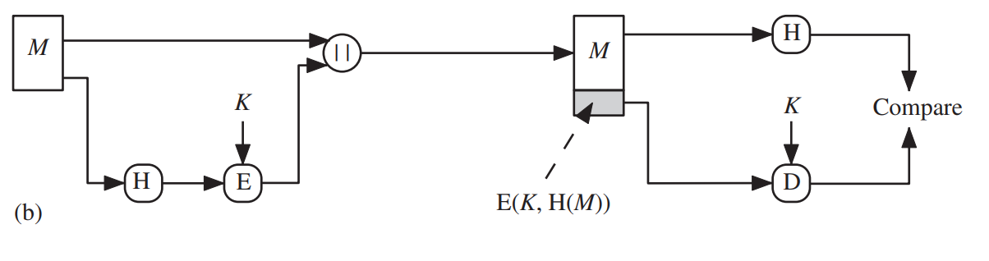
Method 2 – Only hash code is encrypted
Only the hash code is encrypted, using symmetric encryption.
This reduces the processing burden for those applications that do not require confidentiality.

Slide 15
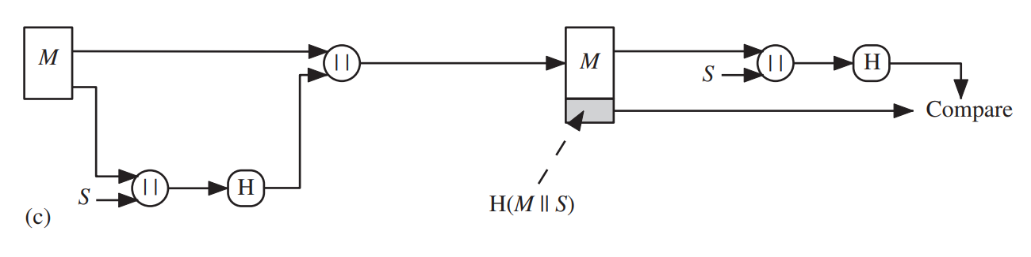
Method 3 – Sharing a secret value for message authentication
It is possible to use a hash function but no encryption for message authentication.
The technique assumes that the two communicating parties share a common secret value S.
A computes the hash value over the concatenation of M and S and appends the resulting hash value to M.
Because B possesses, it can re-compute the hash value to verify.
Because the secret value itself is not sent, an opponent cannot modify an intercepted message and cannot generate a false message.

Slide 16
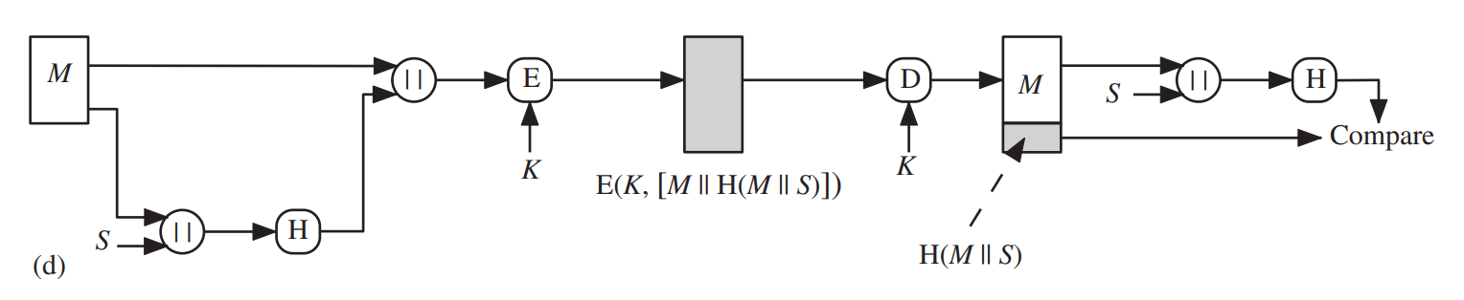
Method 4 – Adding confidentiality to method 3
Confidentiality can be added to the approach of method (c) by encrypting the entire message plus the hash code.

Slide 17
(b) Digital Signature

Slide 18
Digital Signatures
Digital signatures are similar to the message authentication application.
Verify the sender of the received message.
In digital signature, the hash value of a message is encrypted with a user’s private key.
Integrity of the message can be verified by using the user’s public key associated with the digital signature.
Hence, attacker who wishes to alter the message would need to know the user’s private key.

Slide 19
Various Methods for Digital Signature
(using the Hash code)
Method 1 – Authentication
Method – 2 Authentication + Confidentiality

Slide 20
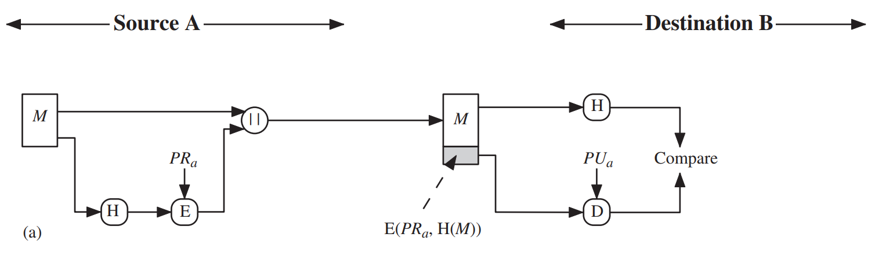
Method 1 - Authentication
The hash code is encrypted, using public-key encryption with the sender’s private key, this provides authentication.
It also provides a digital signature, because only the sender could have produced the encrypted hash code.

Slide 21
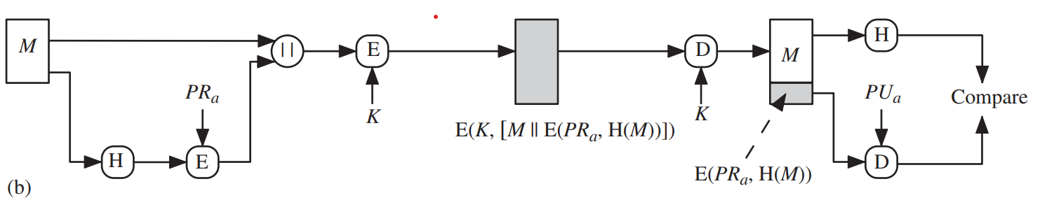
Method – 2 Authentication + Confidentiality
If confidentiality as well as a digital signature is desired, then the message plus the private-key-encrypted hash code can be encrypted using a symmetric secret key

